Slide 2
Machine Learning with ML.NET
Cecil Phillip
Senior Cloud Advocate
@cecilphillip

Slide 3
Agenda
Overview of Machine Learning
What is ML .NET?
Training and Consuming Models
Future Enhancements

Slide 4
What is Machine Learning?

Slide 5
Machine Learning “Programming the Unprogrammable”
{
{
Is this a dog?
Price of shirt?
f(x)
f(x)
“It has exquisite buttons … with long sleeves …works for casual as well as business settings”
Notes:
-One way to think of machine learning is that it’s about programming the unprogrammable -- getting computers to make predictions without being explicitly programmed
-e.g. If I ask you to write a function which determines if an image has a dog in it or not, you might not know where to start…
-Likewise if I ask you to write me a function which predicts the price of a shirt given the description of the shirt, you might start looking for some keywords like long sleeves, or business settings but might not be able to build a function that scales up to a few hundred products.

Slide 6


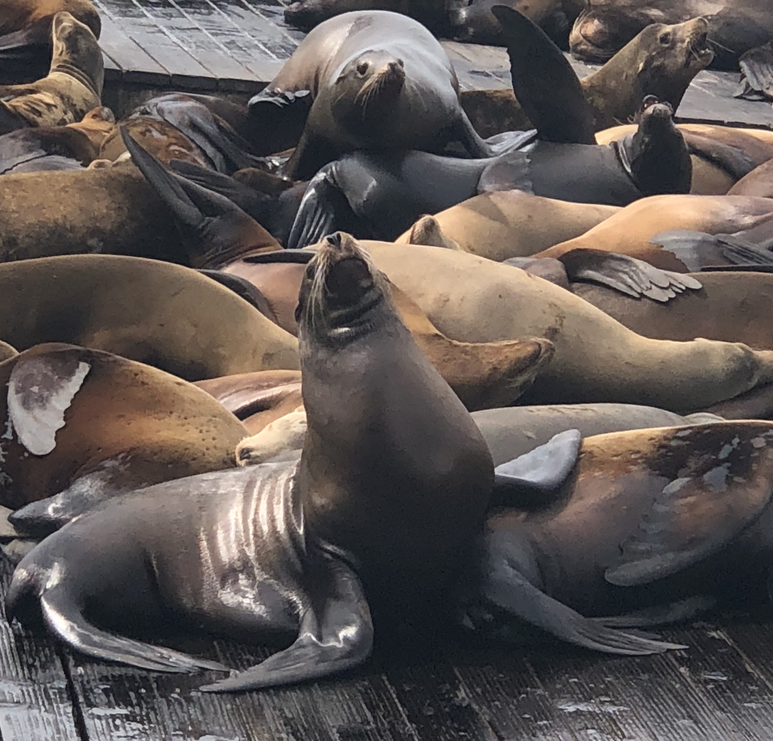
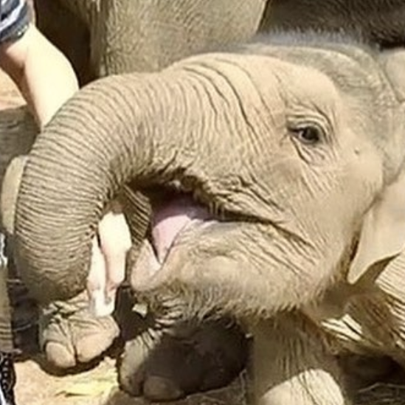
Machine Learning “Programming the Unprogrammable”
{
Machine Learning creates a
Dog
Dog
f(x) Model
Not a dog
Not a dog
using this data
Notes:
-Even though we don’t know how to write that function, we do have examples of inputs and outputs to that function.
-e.g. we have many images and we can label them to say whether they have a dog in them or not
-With Machine Learning you use these examples of inputs and outputs and create a model. Machine learning takes in historical data as input and finds patterns in the data that can then be applied to new data to make predictions.
You can then use this intelligent function or model and take in as input an image and return whether there is a dog in it or not.

Slide 7

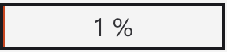
Pre-built vs. Custom Machine Learning Models
Pre-built ML models have been pre-trained and are not customizable – some limitations
Ex: Azure Cognitive Services
Great for some scenarios…
“This is a great vacuum cleaner.”
Not great for others…
“This vacuum cleaner sucks so much dirt.”
Sentiment:
positive
Sentiment:
negative
Use ML Frameworks to create custom models trained on your data

Slide 8
What is ML.NET?

Slide 9





ML.NET An open source and cross-platform machine learning framework
Built for .NET developers
Custom ML made
easy with tools
C#
F#
Extended with TensorFlow & more
Trusted &
proven at scale
Notes:
Use existing .NET skills to easily integrate ML models into your .NET apps
Productive tooling
Leverage other popular libraries like TF and ONNX for additional scenarios
TLC

Slide 10










ML.NET is enterprise-ready battle proven
Microsoft Products
(Using ML.NET internally for > 8 years)
Customers
(ML.NET v1 since May 2019)
Bing - Ad Predictions
Evolution Software – Hazelnut drying time prediction
Excel - Chart Recommendations
Williams Mullen – Law document classification
Power Point - Design Ideas
Sig Parser – E-mail spam detection
Microsoft Defender – Antivirus Threat Protection
Brenmor – Medical patient survey classification
Azure ML Studio – Multiple components
Azure Stream Analytics - Anomaly Detection
endjin – Newsletter article classification
+ more

Slide 11
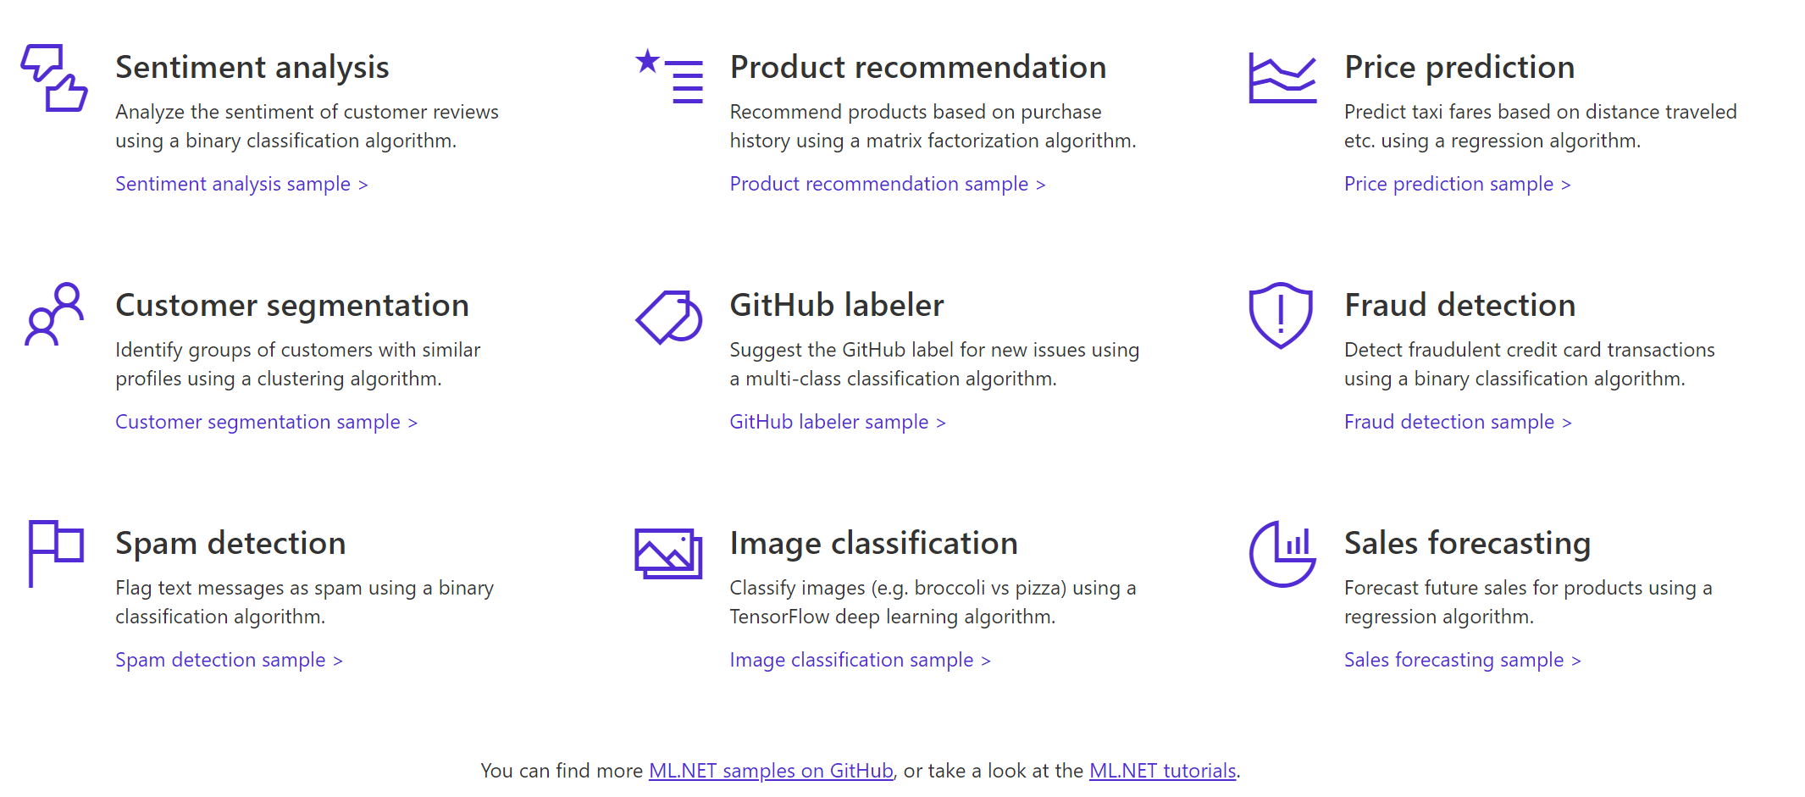

A few things you can do with ML.NET …
And more! Samples @ https://github.com/dotnet/machinelearning-samples
Notes:
So here’s an example of a few things you can do today with ML.NET 1.0
You can perform Sentiment Analysis, build Product recommenders,
forecast sales,
classify images and do a whole lot more.
And for all these scenarios we have provided you sample code for building and consuming these models, let me show you.
____
Dot.net
Here’s our dot.net/ml page which talks about some of the value props I mentioned, heres a list of samples.
So here is our samples repo, Here we have many samples for each ML task e.g. Fraud Detection for classification, Issue Classification, Sales Forecast etc.
For each of these samples we also provide you both the training code and consumption code along with explaining you how we built them
Alright so let me show you one of these samples live.
Here I have the sentiment analysis + blazor application

Slide 12




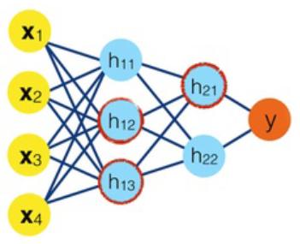



Machine Learning Workflow
Datasets
ML model
ML model
Prepare Your Data
Build & Train
Run
App/tools for training
the ML model
End-user app
using the ML model
Model creation
Model consumption
Notes:
3 main steps
Preparing your data – labeling, merging different data sources, cleaning up the data, and data transformations
Feed prepared data to algorithm and train the model (using algorithm with the data)
Consume model
TALKING POINTS:
There are two very different applications and contexts:
Prepare Data and Train the model Happens at development/research time, in your private app & tools for building the model
You run the model in the end-user application

Slide 13
Model Builder and ML.NET CLI
Easiest way to create an ML.NET model

Slide 14


Three ways to use ML.NET…
C#
>_
ML.NET
API
(Code)
ML.NET
Model Builder
(Visual Studio UI)
ML.NET
CLI
(Command-Line Interface)

Slide 15
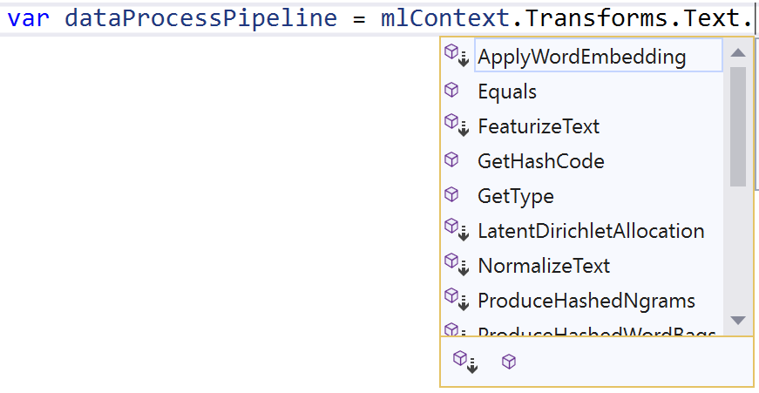
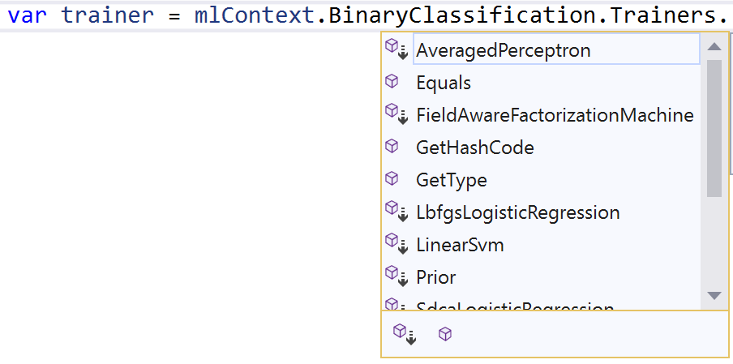
Which transformations are best for my data?
Which algorithm is best for my scenario?
What are the right options for my algorithm?
var options = new LbfgsLogisticRegressionBinaryTrainer.Options()
{
LabelColumnName = "Label",
FeatureColumnName = "Features",
MaximumNumberOfIterations = 100,
OptimizationTolerance = 1e-8f,
L2Regularization = 0.01f
};
Notes:
Heard this feedback over and over in customer development; even at the //build booth, .NET developers would come up and ask “I don’t have any data science background, can I still use ML.NET?”
We also learned from customer development that users were mostly copying the samples from our GitHub and were adapting it to their own scenarios and data.
However, this left the developers with many “data science” questions, such as which data transformations should I use? Which algorithm should I choose and with which options?

Slide 16
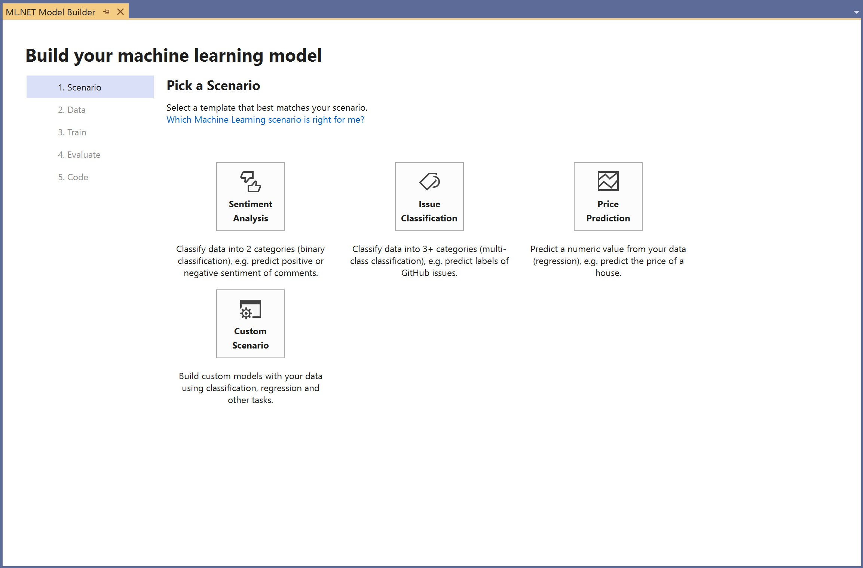
ML.NET Model Builder
Approachable machine learning in Visual Studio
A simple UI to easily build custom ML models with Automated ML
Load from files and databases
Generate code for training and consumption
Run everything local
Download VS vsix:
http://aka.ms/mlnetmodelbuilder

Slide 17
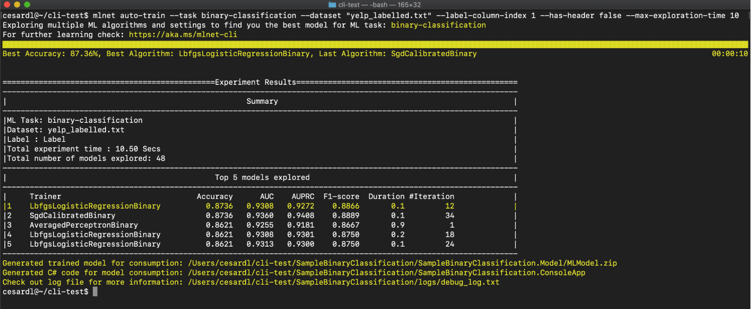
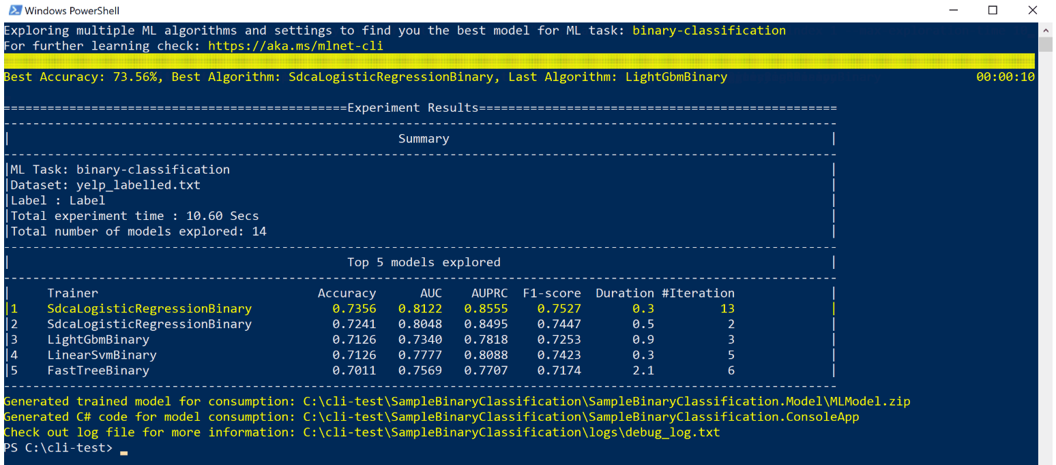
ML.NET CLI
Use the CLI to easily build custom ML models with Automated ML
Cross platform (Windows, Linux, MacOS)
Generate code for training & consumption
macOS / Linux (Bash)
Windows (PowerShell and CMD)
> mlnet auto-train --ml-task binary-classification --dataset "customer-reviews.tsv" --label-column-name Sentiment

Slide 18
Deep Learning in ML.NET

Slide 19
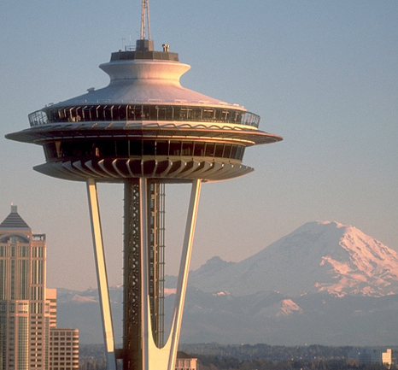
Use Deep Learning models with ML.NET
Add intelligence based on DNN-based models to your .NET apps
Enables computer vision and many more Deep Learning domains
Image (input)
Dog
Not a dog
Dog
Not a dog

Slide 20



Leading libraries in deep learning and interoperability
PyTorch
Microsoft’s strategy is to integrate those low level libraries and runtimes into ML.NET:
Currently supported by ML.NET:
- TensorFlow
- ONNX
In ML.NET long-term roadmap:
- Torch

Slide 21
Leading deep learning ‘pre-trained models’ (DNN architectures)
Computer Vision
Audio and speech
NLP (Natural language processing)
Image classification
Wavenet
espnet
waveblow
deepspeech2
loop
tacotron
etc.
Google InceptionV3
Microsoft ResNet
NASNet
Oxford VGG Model
MobileNetV2
etc.
Generative Models
… other domains …
Object detection
Yolo (You Only Look Once)
R-CNN
SPP-net
Fast R-CNN
Faster R-CNN
etc.
Huge investment/cost in DNN architecture research plus costly training on large datasets made by organizations such as Google, Microsoft, Facebook, Universities and researchers.
You can take advantage of it by simply consuming pre-trained models
https://modelzoo.co/categories
Notes:
https://modelzoo.co/categories
https://cv-tricks.com/object-detection/faster-r-cnn-yolo-ssd/

Slide 22

Consuming pre-trained deep learning models with ML.NET Scenario: Image classifier (Consuming the model)
Pre-trained
Deep learning model
(i.e. Image classifier)
“dog”
“elephant”
“flower”
“person”
“car”
Pre-defined list of
generic labels
Examples of pre-trained models (Image classifiers):
Google Inception v3, NASNet
Microsoft ResNet
Oxford VGG Model, etc.
GitHub sample here
Notes:
An image classifier is a deep learning model that recognizes images. When you give it an image, it responds with a label for that image.
NASNet: https://ai.googleblog.com/2017/11/automl-for-large-scale-image.html

Slide 23
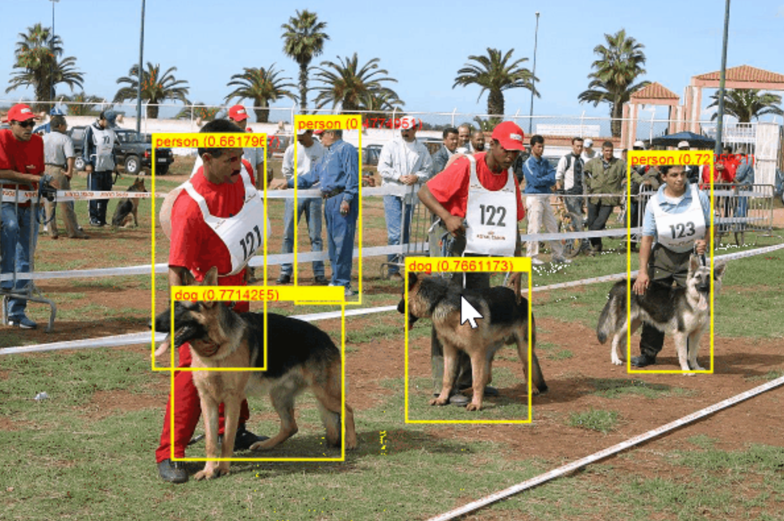

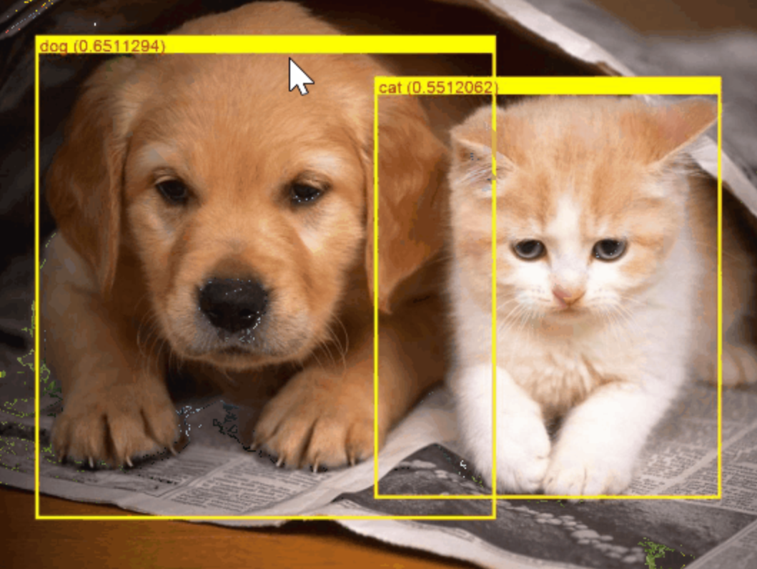

Consuming pre-trained deep learning models with ML.NET Scenario: Object Detection (Consuming the model)
Pre-trained
Deep learning model
(i.e. Object Detection)
Examples of pre-trained
models for obj. detection:
YOLO (You Only Look Once)
Faster R-CNN
SSD, etc.
GitHub sample here
Notes:
An image classifier is a deep learning model that recognizes images. When you give it an image, it responds with a label for that image.
NASNet: https://ai.googleblog.com/2017/11/automl-for-large-scale-image.html

Slide 24
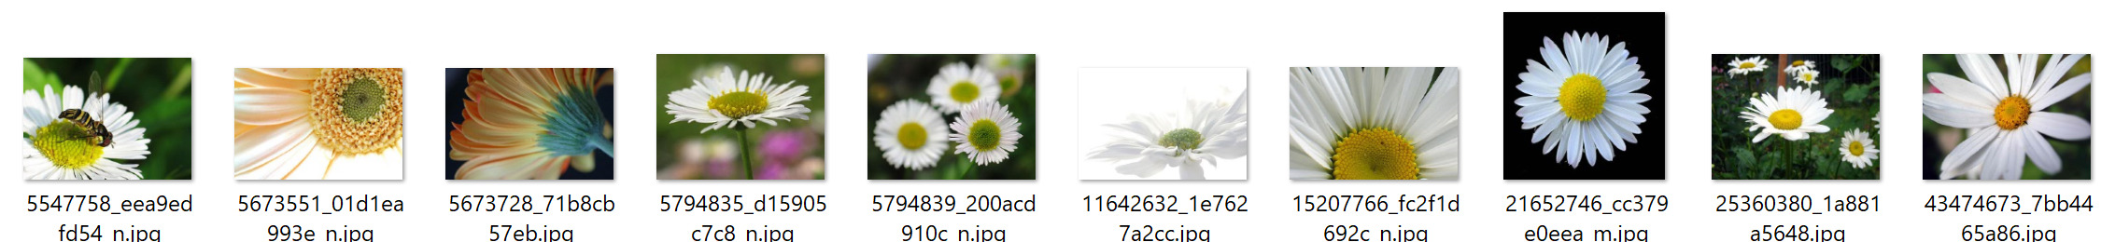
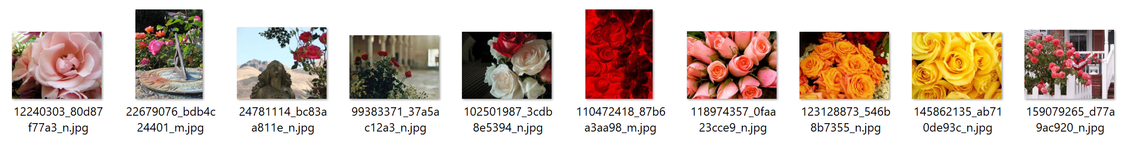

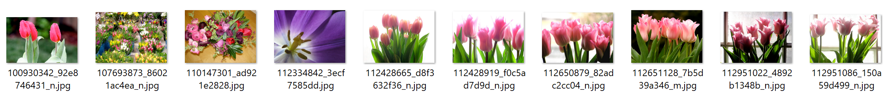
What if I want to classify based on my own custom domain? Scenario: Image classifier (Training)
Then you train your own custom deep learning model with ML.NET
“daisies”
Your custom Image Classifier
(Deep learning model)
“roses”
Train
“tulips”
When training, ML.NET is based on TensorFlow underneath (Transfer Learning).
ML.NET currently supports “ImageClassifier training” ( Preview)
Object Detection training will come soon
Notes:
An image classifier is a deep learning model that recognizes images. When you give it an image, it responds with a label for that image.
NASNet: https://ai.googleblog.com/2017/11/automl-for-large-scale-image.html

Slide 25
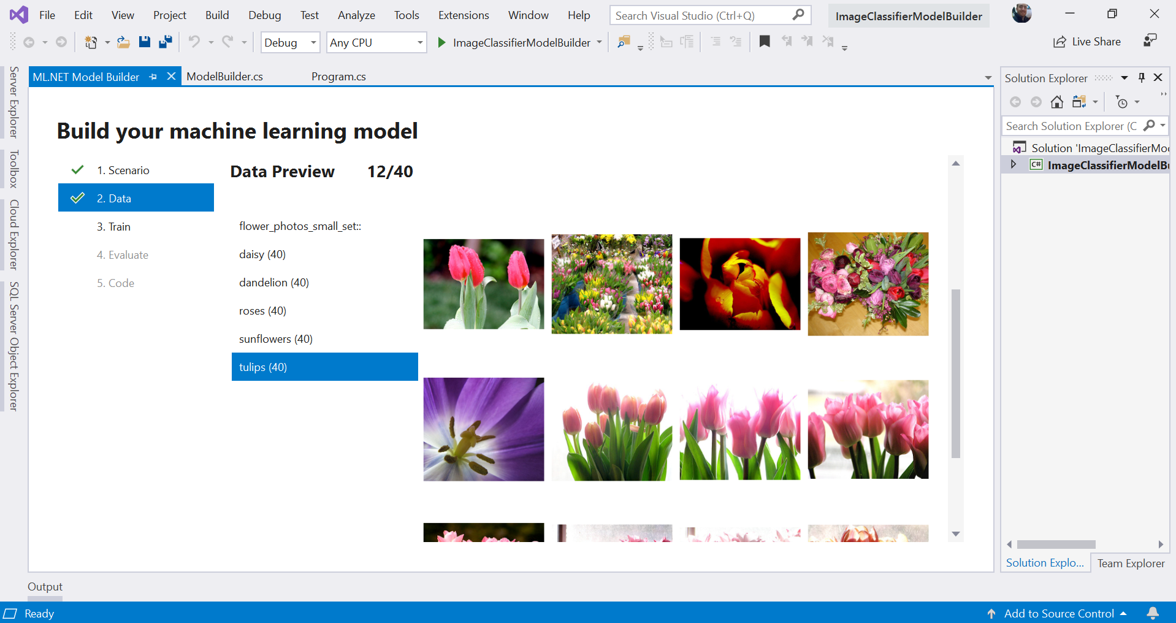
Image Classification in ML.NET Model Builder (VS extension)
A simple UI to easily build custom ML models with Automated ML
Directly load image folders
Generate code for training and consumption
Run everything local
(*) The Image Classifier feature in Model Builder will be public preview in upcoming releases.
As of Sept. 23rd 2019 this feature is still not publicly released in Model Builder, yet.
You can already use the API in public preview, though.
Notes:
An image classifier is a deep learning model that recognizes images. When you give it an image, it responds with a label for that image.
NASNet: https://ai.googleblog.com/2017/11/automl-for-large-scale-image.html

Slide 26
Data exploration and ML experimentation

Slide 27
Roadmap
Introducing deep learning model training (Preview)
Image classification & object detection
Adding database loader (Preview)
Improve AutoML experience for all ML scenarios
Scale-out on Azure for training and consumption
Improve tooling provided with Model Builder & CLI
ARM support (Xamarin & IoT)

Slide 28

ML.NET Resources
Get started at http://dot.net/ml
Try the samples at http://aka.ms/mlnetsamples
Read the docs at http://aka.ms/mlnetdocs
Watch ML.NET videos at https://aka.ms/mlnetyoutube
Request features or contribute at http://aka.ms/mlnet

